Slide 1
Distributed Systems
ARCHITECTURES

Slide 2
Architectural Styles
Important styles of architecture for distributed systems
Layered architectures
Object-based architectures
Data-centered architectures
Event-based architectures

Slide 3
Layered architectures
components are organized in a layered fashion where a component at layer Li
is allowed to call components at the underlying layer Li
widely adopted by the networking community.
control generally flows from layer to layer: requests go down the hierarchy whereas the results flow upward

Slide 4
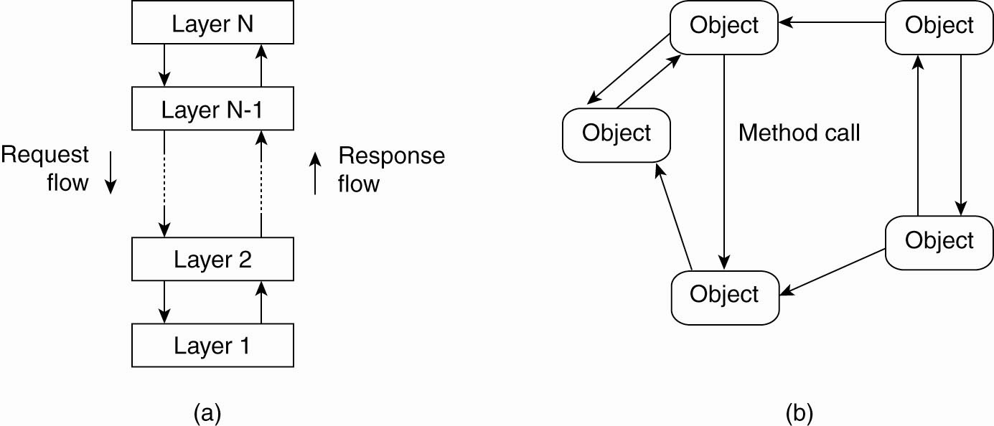
Architectural Styles
Figure 2-1. The (a) layered architectural style and …

Slide 5
Object-based architectures
Each object defined as a component, and these components are connected through a remote procedure call mechanism
This software architecture matches the client-server system architecture
The layered and object based architectures form the most important styles for large software systems

Slide 6
Architectural Styles
Figure 2-1. (b) The object-based architectural style.

Slide 7
Data-centered architectures
In Data-centered architectures processes communicate through a common repository.
Web-based distributed systems are largely data-centric: processes communicate through the use of shared Web-based data services.

Slide 8
Event-based architectures
processes essentially communicate through the propagation of events, which optionally also carry data.
The basic idea is that processes publish events after which the middleware ensures that only those processes that subscribed to those events will receive them.
The main advantage of event-based systems is that processes are loosely coupled

Slide 9
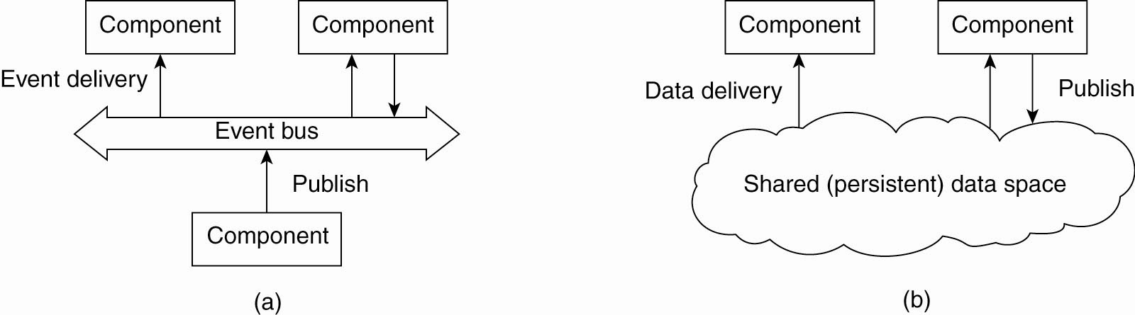
Event-based architectures
Figure 2-2. (a) The event-based architectural style and …

Slide 10
Shared data space architectures
Event-based architectures can be combined with data-centered architectures known as shared data spaces.
In shared data spaces the processes are decoupled in time: they need not both be active when communication takes place.

Slide 11
Shared data space architectures
Figure 2-2. (b) The shared data-space architectural style.

Slide 12
System Architectures
How - distributed systems are actually organized by considering where software components are placed
Deciding on software components, their
interaction- s/w architecture or System architecture.
  Centralized organizations
  De centralized organizations
Tanenbaum & Van Steen, Distributed Systems: Principles and Paradigms, 2e, (c) 2007 Prentice-Hall, Inc. All rights reserved. 0-13-239227-5

Slide 13
Centralized Architectures
In the basic client-server model, processes in a distributed system are divided into two groups.
A server is a process implementing a specific service.
A client is a process that requests a service from a server by sending it a request and waiting for the server's reply.
Also known as request-reply behavior

Slide 14
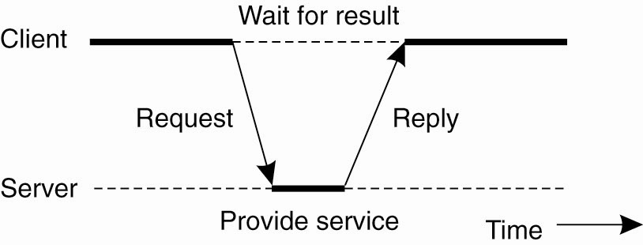
Centralized Architectures
Figure 2-3. General interaction between a client and a server.

Slide 15
Centralized Architectures
Communication between a client and a server can be implemented by means of connectionless protocol when the underlying network is reliable
when a client requests a service, it packages a message for the server, identifying the service it wants, along with the necessary input data.
The message is then sent to the server.
wait for an incoming request, subsequently process it, and package the results in a reply message that is then sent to the client.

Slide 16
Centralized Architectures
Many client-server systems use a reliable connection oriented protocol.
This solution is not entirely appropriate in a local-area network due to relatively low performance but works perfectly tine in wide-area systems in which communication is inherently unreliable.

Slide 17
Application Layering
Layers of architectural style
The user-interface level
The processing level
The data level

Slide 18
The user-interface level
The user-interface level: contains all that is necessary to directly interface with the user.
Clients implement the user-interface level.
This level consists of the programs that allow end users to interact with applications

Slide 19
The processing level
Contains the applications.
Many client-server applications can be constructed from different pieces
handles interaction with a user
operates on a database or file system
middle part that contains the core functionality
of an application. This middle part is logically placed at the processing level

Slide 20
The data level
The data level: manages the actual data that is being acted on.
An important property of this level is that data are often persistent i.e even if no application is running, data will be stored somewhere for next use
Data level is generally responsible for
keeping data consistent across different applications

Slide 21
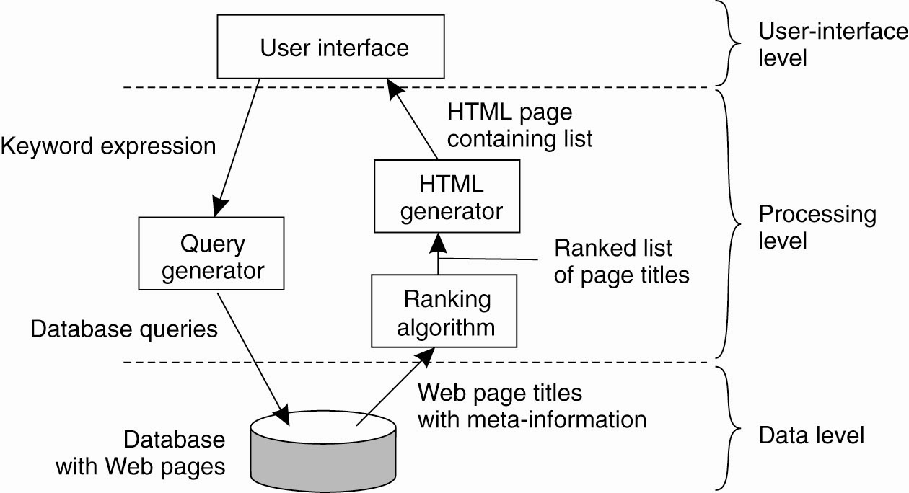
Application Layering
Figure 2-4. The simplified organization of an Internet search engine into three different layers.

Slide 22
Multi tiered Architectures
The simplest organization is to have only two types of machines:
A client machine containing only the programs implementing the user-interface level
A server machine containing the rest
  the programs implementing the processing and data level

Slide 23
Multi tiered Architectures
Multi tiered client-server architectures are a direct consequence of dividing applications into a user-interface, processing components, and a data level.
The different tiers correspond directly with the logical organization of applications

Slide 24
Multi tiered Architectures
other possibilities:
Distribute the programs in the application layers of the previous section across different machines.
To have only the terminal-dependent part of the user interface on the client machine and give the applications remote control over the presentation of their data Fig. 2-5(a)

Slide 25
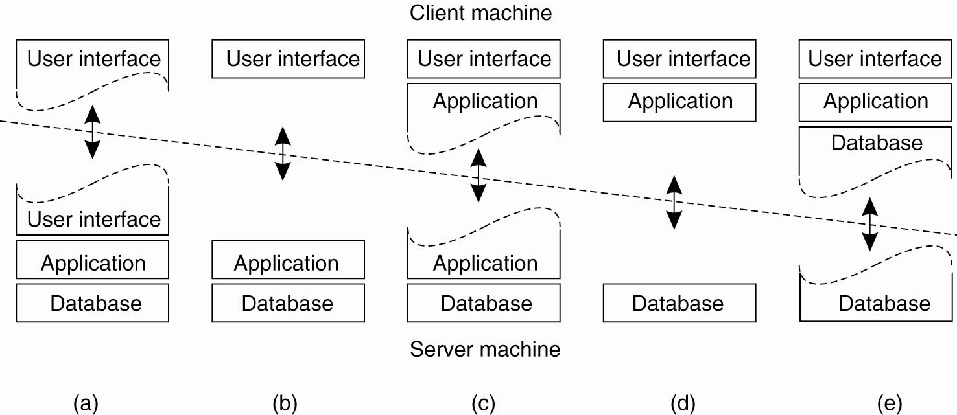
Multi tiered Architectures
Figure 2-5. Alternative client-server organizations (a)–(e).

Slide 26
Multi tiered Architectures
other possibilities:
To place the entire user-interface software on the client side, essentially divide the application into a graphical front end, which
communicates with the rest of the aplication through an application-specific protocol
In this model, the front end does no processing other than necessary for presenting the application's interface-
Fig 2.5(b)

Slide 27
Multi tiered Architectures
other possibilities:
move part of the application to the front end.
The front end can then check correctness and consistency of the form, and where necessary interact with the user Fig. 2-5(c)
The client machine is a PC or workstation, connected through a network to a distributed
file system or database
most of the application is running on the client machine, but all operations on files or database entries go to the server

Slide 28
Multi tiered Architectures
Three tired Architecture
programs that form part of the processing level reside on a separate server, but may additionally be partly distributed across the client and server machines.

Slide 29
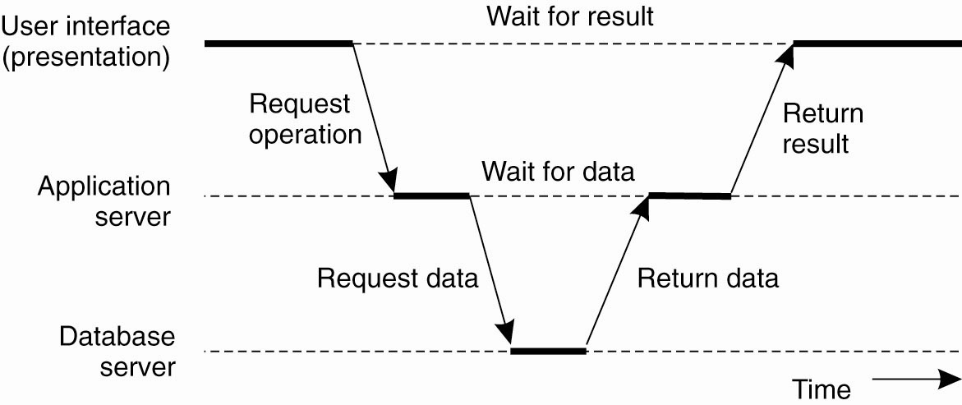
Multi tiered Architectures
Figure 2-6. An example of a server acting as client.

Slide 30
Decentralized Architectures
Structured Peer-to-Peer Architectures
Unstructured Peer-to-Peer Architectures

Slide 31
Structured Peer-to-Peer Architectures
In this architecture, the overlay network is constructed using a deterministic procedure
most-used procedure is to organize the processes through a distributed hash table
Data items are assigned a random key from a large identifier space
Nodes in the system are also assigned a random number from the same identifier space.
To implement an efficient and deterministic scheme that uniquely maps the key of a data item to the identifier of a node based on some distance metric
When looking up a data item, the network address of the node responsible for that data item is returned.
This is accomplished by routing a request for a data item to the responsible node.

Slide 32
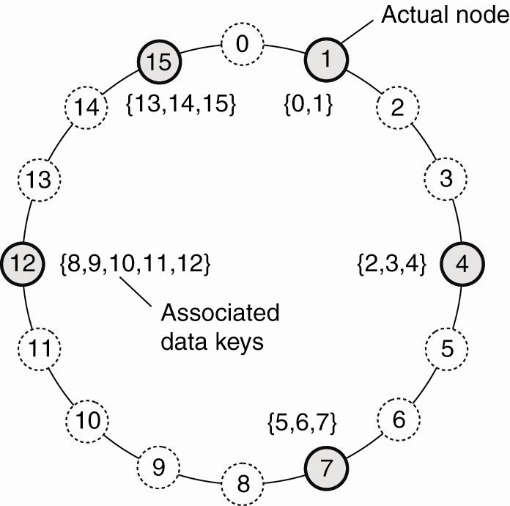
Structured Peer-to-Peer Architectures (1)
Figure 2-7. The mapping of data items onto nodes in Chord.

Slide 33
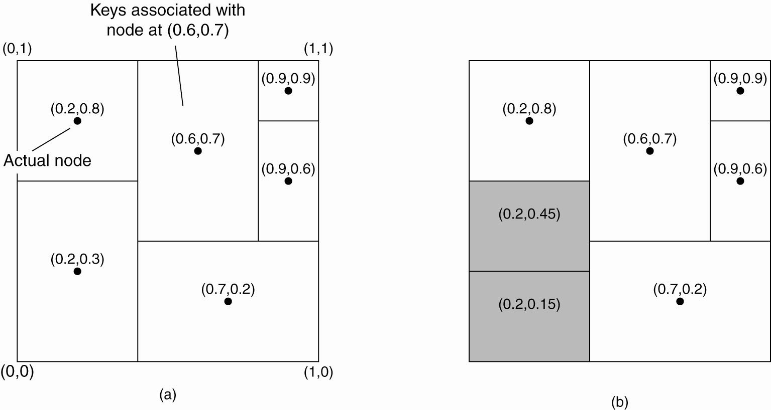
Structured Peer-to-Peer Architectures (2)
Figure 2-8. (a) The mapping of data items onto nodes in CAN.

Slide 34
Structured Peer-to-Peer Architectures (3)
Figure 2-8. (b) Splitting a region when a node joins.

Slide 35
Unstructured Peer-to-Peer Architectures
These systems largely rely on randomized algorithms for
constructing an overlay network.
The main idea is that each node maintains a list of neighbors, but this list is constructed in a random way.
Data items are assumed to be randomly placed on nodes.
when a node needs to locate a specific data item flood the network with a search que.
One of the goals of many unstructured peer-to-peer systems is to construct an overlay network that resembles a random graph.
The basic model is that each node maintains a list of c neighbors

Slide 36
Topology Management of Overlay Networks
Topology management is achieved by adopting a two layered approach
The lowest layer constitutes an unstructured peer-to-peer system in which nodes periodically exchange entries of their partial views with the aim to maintain an accurate random graph.
The lowest layer passes its partial view to the higher layer, where an additional selection of entries takes place.
This then leads to a second list of neighbors corresponding to the desired topology

Slide 37
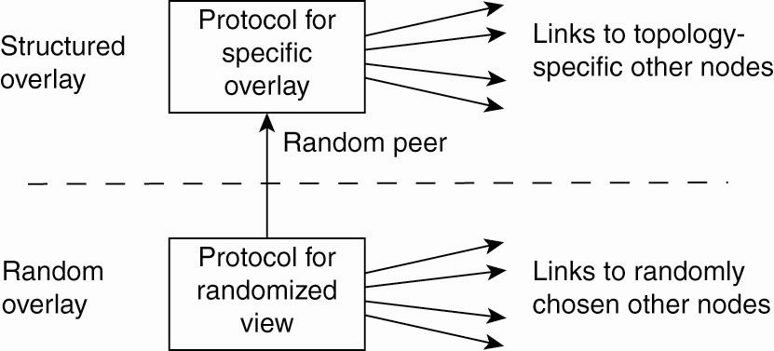
Topology Management of Overlay Networks (1)
Figure 2-10. A two-layered approach for constructing and maintaining specific overlay topologies using techniques from unstructured peer-to-peer systems.

Slide 38
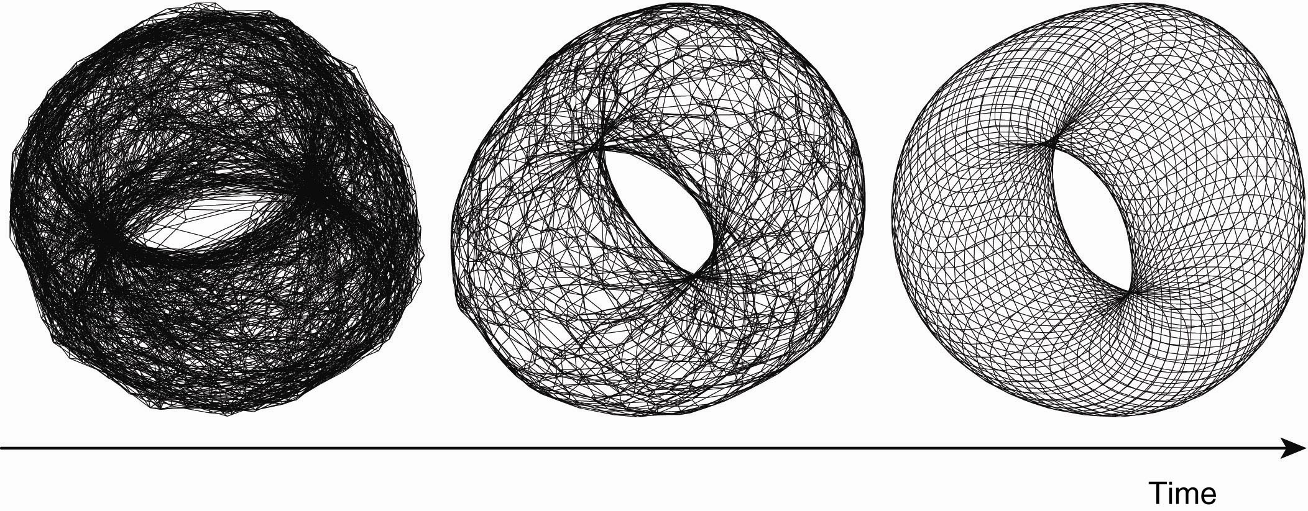
Topology Management of Overlay Networks (2)
Figure 2-11. Generating a specific overlay network using a two-layered unstructured peer-to-peer system [adapted with permission from Jelasity and Babaoglu (2005)].

Slide 39
Superpeers
Nodes those maintaining an index referred to as superpeers.
Superpeers are often organized in a peer-to-peer network, leading to a hierarchical organization
In this organization, every regular peer is connected
as a client to a superpeer. All communication from and to a regular peer proceeds through that peer's associated superpeer
Generally the client-superpeer relation is fixed whenever a regular peer joins the network, it attaches to one of the superpeers and remains attached until it leaves the network.

Slide 40
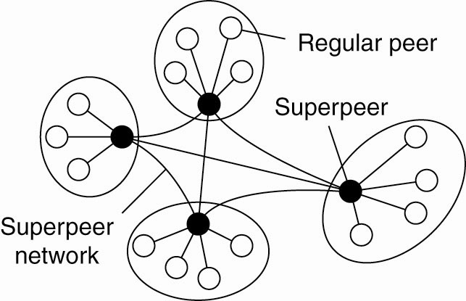
Superpeers
Figure 2-12. A hierarchical organization of nodes into a
superpeer network.

Slide 41
Hybrid Architectures
Many distributed systems combine architectural features of distributed systems in which client-server solutions with decentralized architectures

Slide 42
Edge-Server Systems
An important class of distributed systems that is organized according to a hybrid architecture is formed by edge-server systems.
These systems are deployed on the Internet where servers are placed "at the edge" of the network.
This edge is formed by the boundary between enterprise networks and the actual Internet.
End users at home connect to the Internet through their ISP, the ISP can be considered as residing at the edge of the Internet.
The edge server's main purpose is to serve content
Collection of edge servers can be used to optimize content and application distribution

Slide 43
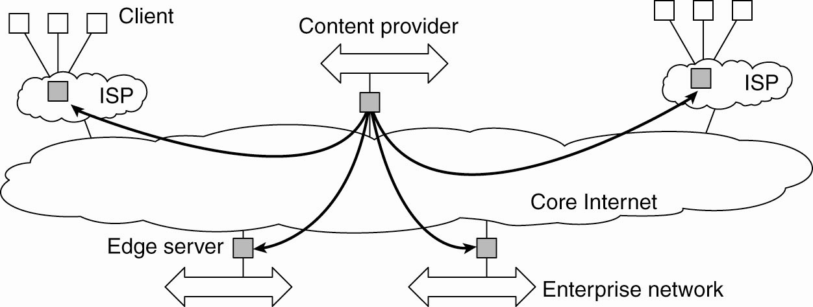
Edge-Server Systems
Figure 2-13. Viewing the Internet as consisting of a
collection of edge servers.

Slide 44
Collaborative Distributed Systems
Hybrid structures are deployed in collaborative distributed systems.
The main issue in many of these systems to first get started, for which often a traditional client-server scheme is deployed.
Once a node has joined the system, it can use a fully decentralized scheme for collaboration.
Ex: BitTorrent and Globule systems
BitTorrent combines centralized with decentralized solutions.
The bottleneck of the system is formed by the trackers in BitTorrent

Slide 45
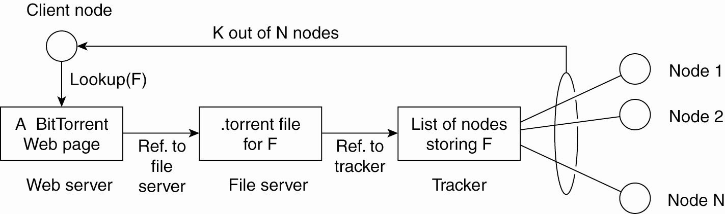
Collaborative Distributed Systems
Figure 2-14. The principal working of BitTorrent [adapted with permission from Pouwelse et al. (2004)].

Slide 46
Collaborative Distributed Systems
Globule resembles the edge server architecture
But instead of edge servers, end users voluntarily provide enhanced Web servers that are capable of collaborating in the replication of Web pages.
Each such server has the following components:
A component that can redirect client requests to other servers.
A component for analyzing access patterns.
A component for managing the replication of Web pages.

Slide 47
ARCHITECTURES VERSUS MIDDLEWARE
When considering the architectural issues a question
that comes is where middleware fits in
Middleware forms a layer between applications and distributed platforms.
An important purpose is to provide a degree of distribution transparency: hiding the distribution of-data, processing, and control from applications.

Slide 48
ARCHITECTURES VERSUS MIDDLEWARE
Middleware systems actually follow a specific architectural style
Having middleware molded according to a specific architectural style has the benefit that designing applications may become simpler.
But the drawback is that the middleware may no longer be optimal for what an application developer had in mind and specific solutions should be adaptable to application requirements.

Slide 49
ARCHITECTURES VERSUS MIDDLEWARE
One solution to this problem is to make several versions of a middleware system, where each version is tailored to a specific class of applications.
Better approach is to make middleware systems
such that they are easy to configure, adapt, and customize as needed by an application.
This has led to several mechanisms by which the behavior of middleware can be modified

Slide 50
Interceptors
An interceptor is a software construct that will break the usual flow of control and allow other application specific code to be executed.
To make interceptors generic may require a substantial implementation effort and it is unclear whether in such cases generality should be preferred over restricted applicability and simplicity.
Also, in many cases having only limited interception facilities will improve management of the software and the distributed system as a whole.

Slide 51
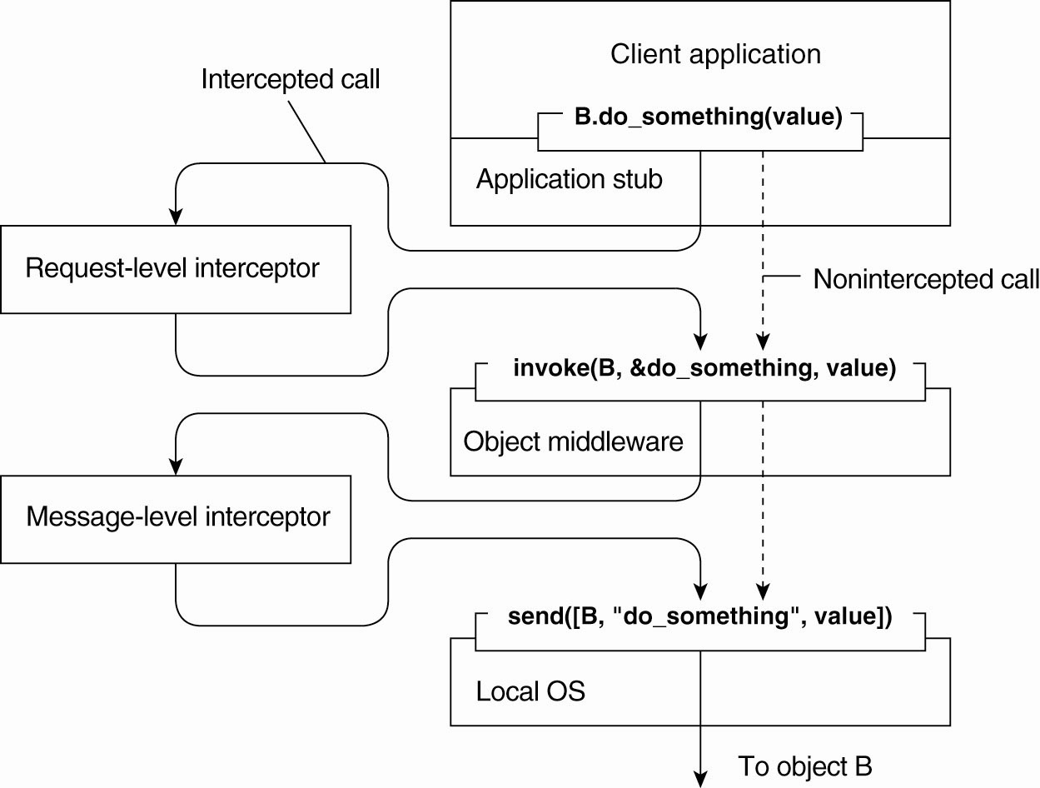
Interceptors
Figure 2-15. Using interceptors to handle
remote-object invocations.

Slide 52
General Approaches to Adaptive Software
Interceptors offer is a means to adapt the middleware.
The need for adaptation comes from the fact that the environment in which distributed applications are executed changes continuously.
Changes include those resulting from mobility, a strong variance in the quality-of-service of networks, failing,
hardware, and battery drainage, amongst others.
Rather than making applications responsible for reacting to changes, this task is placed in the middleware.

Slide 53
General Approaches to Adaptive Software
Three basic approaches to adaptive software:
Separation of concerns
Computational reflection
Component-based design

Slide 54
Separation of concerns
Separate the parts that implement functionality from those that take care of other things such as reliability, performance, security etc.
The main problem is that we cannot easily separate these extra functionalities by means of modularization

Slide 55
Computational reflection
Computational reflection refers to the ability of a program to inspect itself and, if necessary, adapt its behavior

Slide 56
Component-based design
Component-based design supports adaptation through composition.
A system may either be configured statically at design time, or dynamically at runtime.

